Slide 1
RANSAC CS B657 Spring 2017

Slide 2
Degrees of freedom
5
6
Notes:
How many known points are needed to estimate this?

Slide 3
Vanishing Point = Projection from Infinity

Slide 4
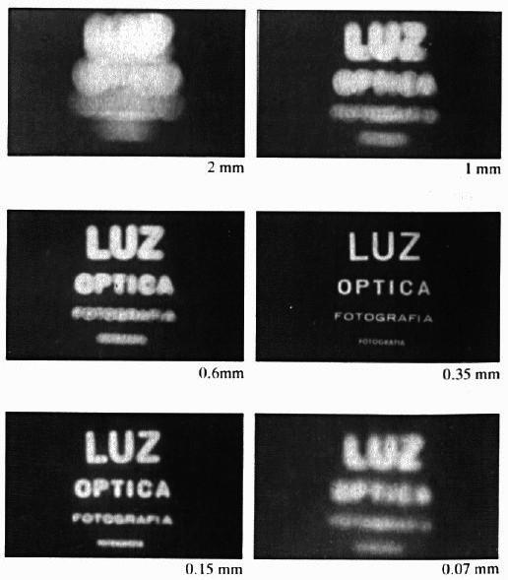
Shrinking the aperture

Slide 5
Adding a lens
Object
Lens
Film
“circle of
confusion”
A lens focuses light onto the film
There is a specific distance at which objects are “in focus”; other points project to a “circle of confusion” in the image
Changing the shape of the lens changes this distance

Slide 6
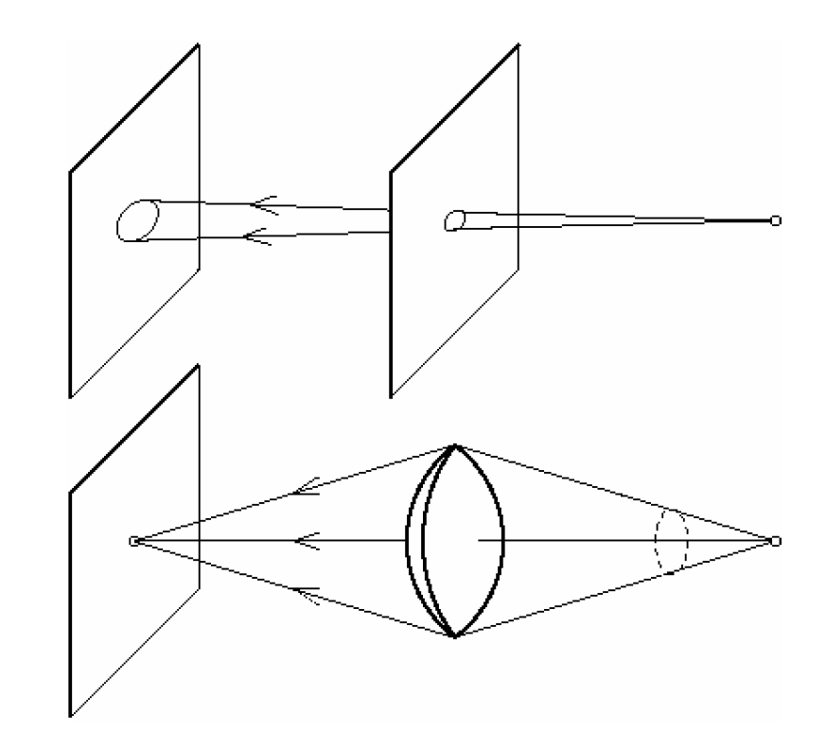
Pinhole vs. lens

Slide 7
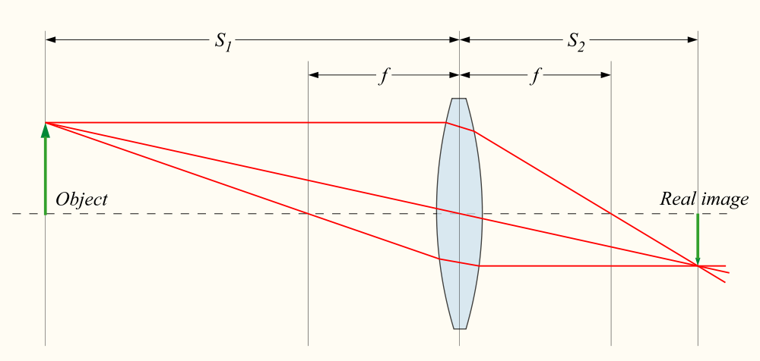

Thin lenses
Thin lens equation:
Any object point satisfying this equation is in focus

Slide 8
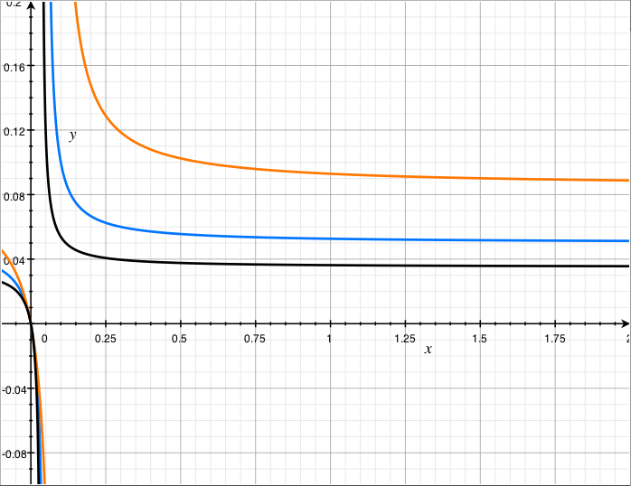
Distance to image plane (S₂), in m
f=85mm
f=50mm
f=35mm
Distance to object (S₁), in m

Slide 9

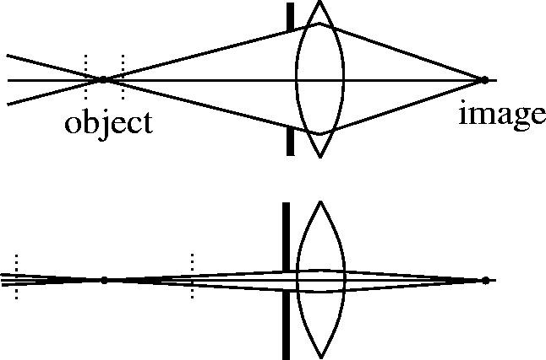

Depth of Field
f / 5.6
f / 32
Changing the aperture size affects depth of field
A smaller aperture increases the range in which the object is approximately in focus
Flower images from Wikipedia http://en.wikipedia.org/wiki/Depth_of_field

Slide 10
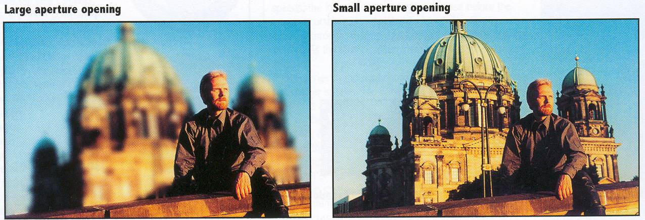
Depth of Field

Slide 11
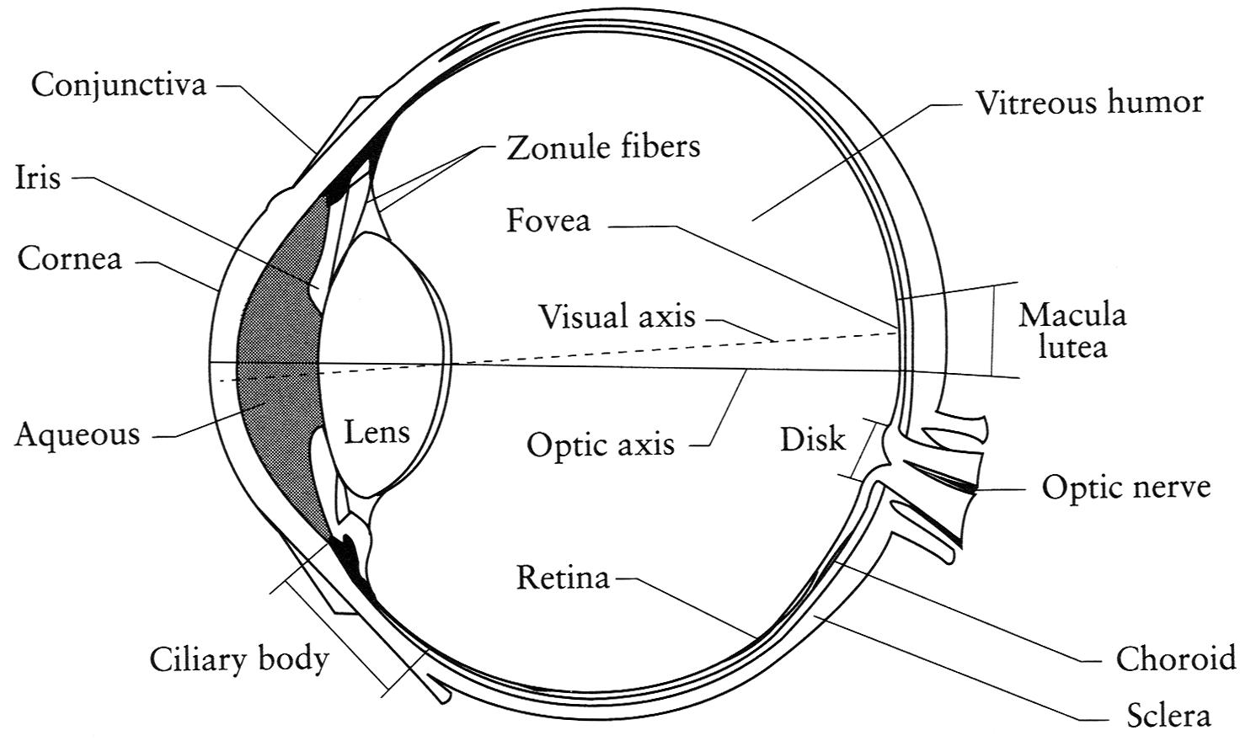
The eye
The human eye is a camera
Pupil -- the “aperture” whose size is controlled by the iris
Lens
Retina – the “film,” with photoreceptive cells called rods and cones
Notes:
Note that the retina is curved

Slide 12
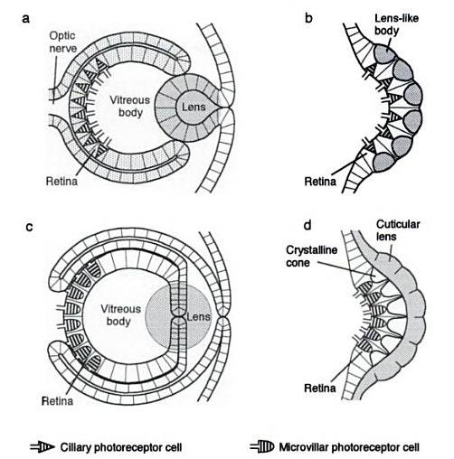
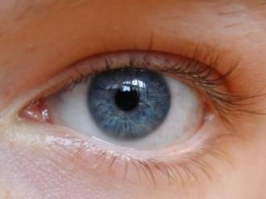
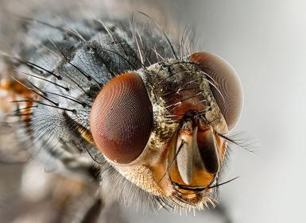
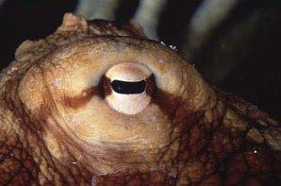

Eyes in nature
(polychaete fan worm)
Source: Animal Eyes, Land & Nilsson

Slide 13
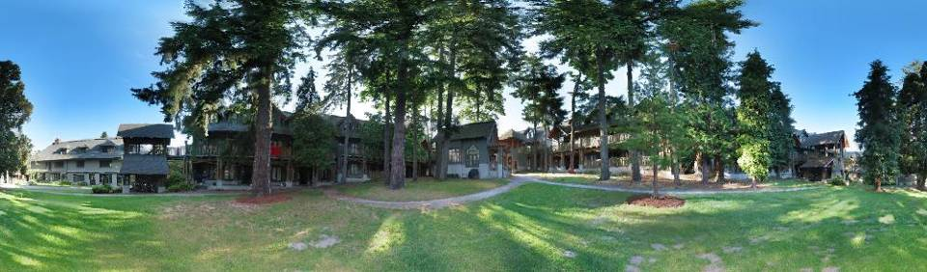
An application: Panoramas
Full screen panoramas (cubic): http://www.panoramas.dk/
Mars: http://www.panoramas.dk/fullscreen3/f2_mars97.html
2003 New Years Eve: http://www.panoramas.dk/fullscreen3/f1.html

Slide 14

Why Mosaic?
Are you getting the whole picture?
Compact Camera FOV = 50 x 35°
Slide from Brown & Lowe

Slide 15
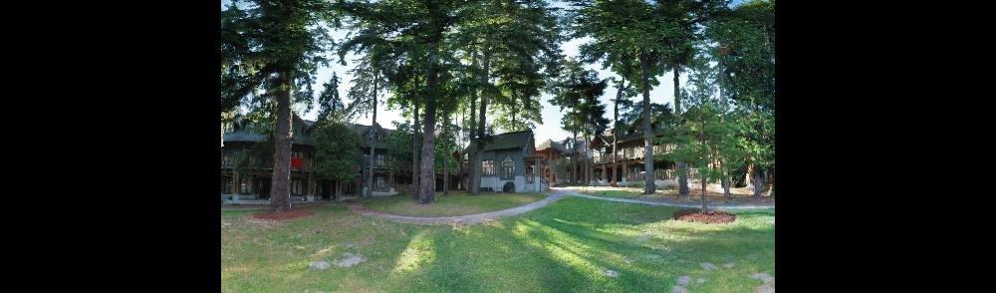
Why Mosaic?
Are you getting the whole picture?
Compact Camera FOV = 50 x 35°
Human FOV = 200 x 135°
Slide from Brown & Lowe

Slide 16
Why Mosaic?
Are you getting the whole picture?
Compact Camera FOV = 50 x 35°
Human FOV = 200 x 135°
Panoramic Mosaic = 360 x 180°
Slide from Brown & Lowe

Slide 17
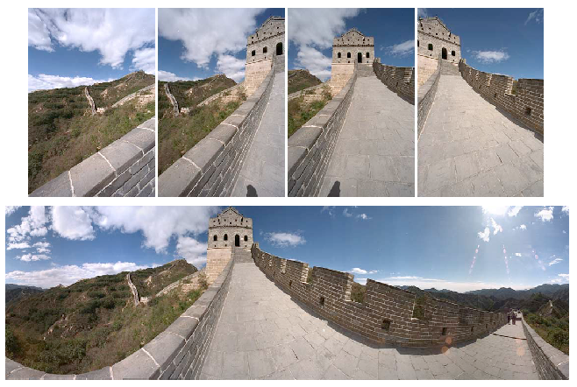
Mosaics: stitching images together

Slide 18
Creating a panorama
Basic Procedure
Take a sequence of images from the same position (rotate camera about its optical center)
Compute transformation between second image and first
Transform the second image to overlap with the first
Blend the two together to create a mosaic
If there are more images, repeat

Slide 19
Geometric Interpretation of Mosaics
Image 2
Optical Center
Image 1
If we capture all 360º of rays, we can create a 360º panorama
The basic operation is projecting an image from one plane to another
The projective transformation is scene-independent, if all images have the same optical center

Slide 20
Image reprojection
How to relate two images having the same camera center?
Cast a ray through each pixel in PP1
Draw the pixel where that ray intersects PP2.
PP2
PP1

Slide 21
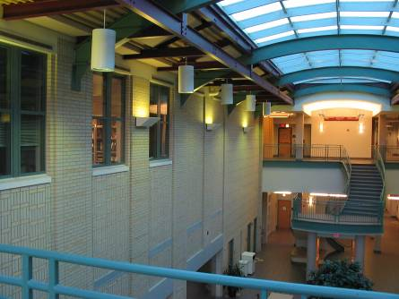
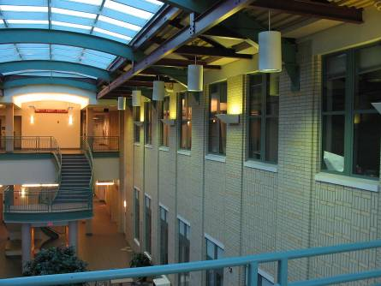
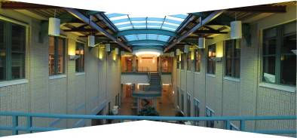
What is the transformation?
left on top
right on top
Translations are not enough to align the images

Slide 22
What is the transformation?
Find point p₁=(x₁,y₁) in image 1 corresponding to given point p₂ (x₂,y₂) in Image 2
Given: 3x3 intrinsic calibration matrices K₁ and K₂, no camera translation, 3x3 camera rotations R₁, R₂

Slide 23
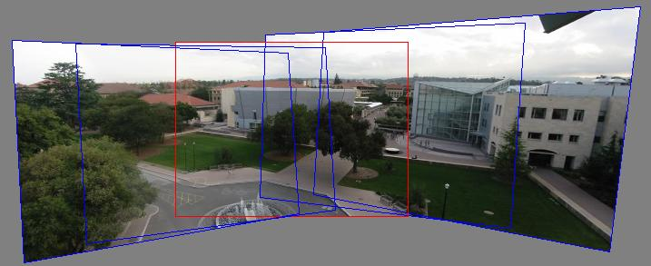
Can we use homography to create a 360 panorama?

Slide 24
Panoramas
What if you want a 360° field of view?
mosaic Projection Sphere

Slide 25




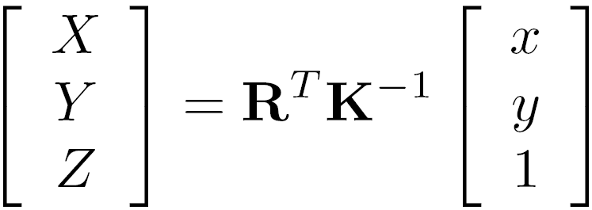

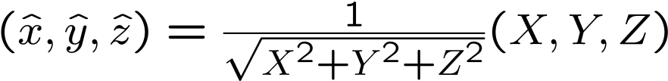



Spherical projection
Map image point to a ray in the world
Y
Z
X
Map 3D point (X,Y,Z) onto unit sphere
unit sphere
Convert to spherical coordinates
unwrapped sphere
Convert to spherical image coordinates
s defines size of the final image
often convenient to set s = camera focal length
Spherical image

Slide 26
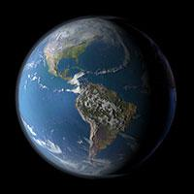

Unwrapping a sphere
Credit: JHT’s Planetary Pixel Emporium

Slide 27
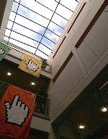
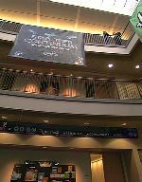
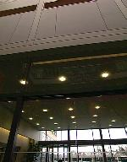


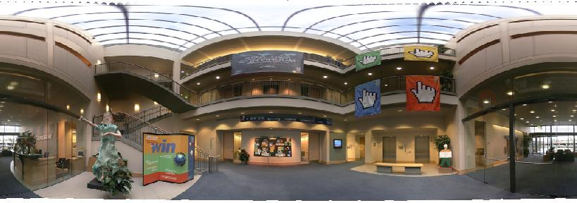
Spherical panoramas
+
+
+
+
Microsoft Lobby: http://www.acm.org/pubs/citations/proceedings/graph/258734/p251-szeliski

Slide 28
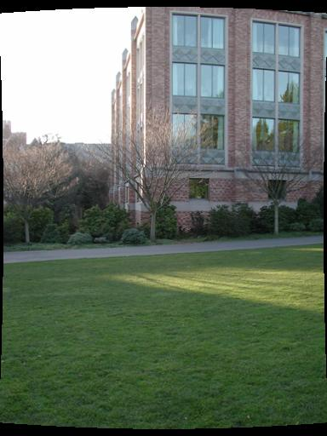
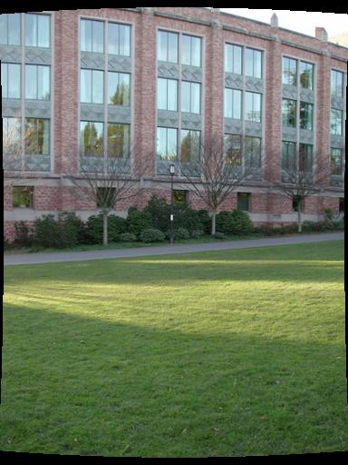
Aligning spherical images
Suppose we rotate the camera by θ about the vertical axis
How does this change the spherical image?
Notes:
Therefore, it is desirable if the global motion model we need to recover is translation, which has only two parameters. It turns out that for a pure panning motion, if we convert two images to their cylindrical maps with known focal length, the relationship between them can be represented by a translation.
Here is an example of how cylindrical maps are constructed with differently with f’s. Note how straight lines are curved.
Similarly, we can map an image to its longitude/latitude spherical coordinates as well if f is given.

Slide 29
Aligning spherical images
Suppose we rotate the camera by θ about the vertical axis
How does this change the spherical image?
Translation by θ
This means that we can align spherical images by translation
(This doesn’t quite work out if we rotate by φ about a horizontal axis)
Notes:
Therefore, it is desirable if the global motion model we need to recover is translation, which has only two parameters. It turns out that for a pure panning motion, if we convert two images to their cylindrical maps with known focal length, the relationship between them can be represented by a translation.
Here is an example of how cylindrical maps are constructed with differently with f’s. Note how straight lines are curved.
Similarly, we can map an image to its longitude/latitude spherical coordinates as well if f is given.

Slide 30
Image alignment
?
Given two images, how do we compute the transformation that aligns them?
Answer: use feature matching
Notes:
Therefore, it is desirable if the global motion model we need to recover is translation, which has only two parameters. It turns out that for a pure panning motion, if we convert two images to their cylindrical maps with known focal length, the relationship between them can be represented by a translation.
Here is an example of how cylindrical maps are constructed with differently with f’s. Note how straight lines are curved.
Similarly, we can map an image to its longitude/latitude spherical coordinates as well if f is given.

Slide 31
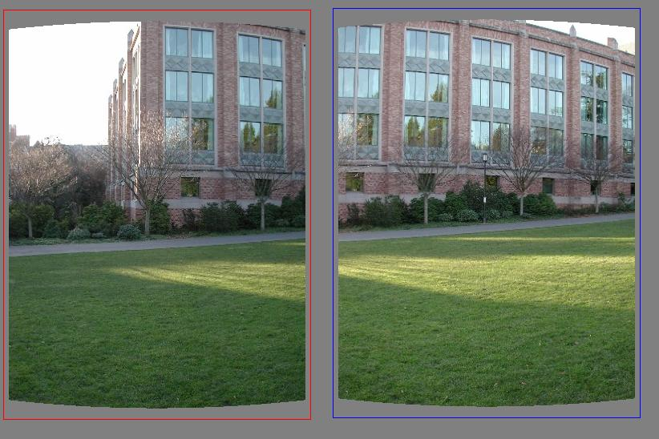
Feature-based alignment
Each matching feature gives us an independent estimate of the translation vector
How do we combine these together?
What about the bad matches?

Slide 32
RAndom SAmple Consensus
Select one match at random, count inliers

Slide 33
RAndom SAmple Consensus
Select another match at random, count inliers

Slide 34
RAndom SAmple Consensus
Output the translation with the highest number of inliers

Slide 35
RANSAC
Proposed by Fischler & Bolles, 1981
Idea:
All the inliers will agree with each other on the translation vector; the (hopefully small) number of outliers will (hopefully) disagree with each other
RANSAC only has guarantees if there are < 50% outliers

Slide 36
RANSAC
Pick a match at random
Compute the translation for that match
also called the “hypothesis”
Count the number of inlier matches (matches that agree with that translation)
What does it mean to agree?
Repeat some number of times
How many?
The winning hypothesis is one with highest vote

Slide 37
RANSAC
Inlier threshold related to the amount of noise we expect in inliers
Often model noise as Gaussian with some standard deviation (e.g., 3 pixels)

Slide 38
RANSAC
y translation
set threshold so that, e.g., 95% of the Gaussian
lies inside that radius
x translation

Slide 39
RANSAC
Inlier threshold related to the amount of noise we expect in inliers
Often model noise as Gaussian with some standard deviation (e.g., 3 pixels)
Number of rounds related to the percentage of outliers we expect, and the probability of success we’d like to guarantee
Suppose there are 20% outliers, and we want to find the correct answer with 99% probability
Q: How many rounds do we need?
A: Solve for N such that 1-(0.2)^{N} ≥ 0.99

Slide 40
RANSAC
RANSAC can be used to fit any parametric model in the presence of outliers
e.g., linear regression (line fitting)
y
y
x
x
“fit a line y = ax + b to these data points”
one solution: solve for a, b that minimize the sum of squared vertical distance to the line

Slide 41
RANSAC
RANSAC can be used to fit any parametric model in the presence of outliers
e.g., linear regression (line fitting)
y
y
x
x
“fit a line y = ax + b to these data points”
one solution: solve for a, b that minimize the sum of squared vertical distance to the line
alternative: use RANSAC
(need 2 points to generate a hypothesis)

Slide 42
Solving for homographies (projective warps between images)

Slide 43
RANSAC
General version:
Randomly choose s samples
Typically s = minimum sample size that lets you fit a model
Fit a model (e.g., line) to those samples
Count the number of inliers that approximately fit the model
Repeat N times
Choose the model that has the largest set of inliers

Slide 44
How many rounds?
If we have to choose s samples each time
with an outlier ratio e
and we want the right answer with probability p
A: N such that 1-(1-(1-e)^{s})^{N} ≥ p
 | proportion of outliers e
s | 5% | 10% | 20% | 25% | 30% | 40% | 50%
2 | 2 | 3 | 5 | 6 | 7 | 11 | 17
3 | 3 | 4 | 7 | 9 | 11 | 19 | 35
4 | 3 | 5 | 9 | 13 | 17 | 34 | 72
5 | 4 | 6 | 12 | 17 | 26 | 57 | 146
6 | 4 | 7 | 16 | 24 | 37 | 97 | 293
7 | 4 | 8 | 20 | 33 | 54 | 163 | 588
8 | 5 | 9 | 26 | 44 | 78 | 272 | 1177
p = 0.99
Source: M. Pollefeys

Slide 45
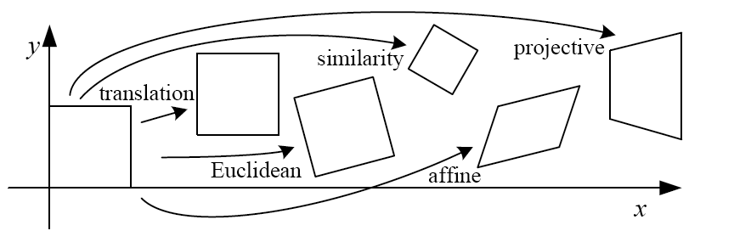
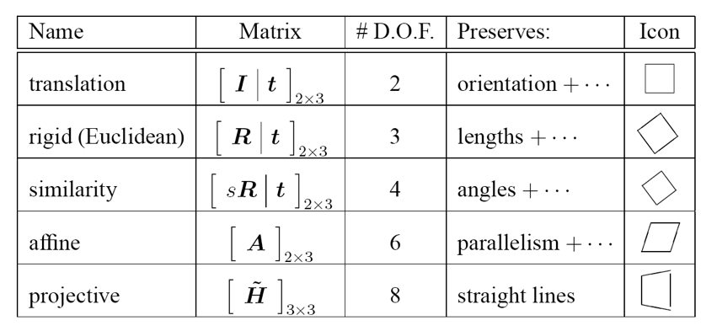
How big is s?
For alignment, depends on the motion model
Here, each sample is a correspondence (pair of matching points)

Slide 46
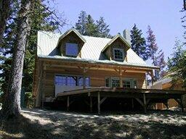
Euclidean: # correspondences?
?
T(x,y)
y
y’
x
x’
How many DOF?
How many correspondences needed for translation+rotation?

Slide 47
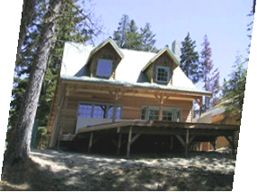
Affine: # correspondences?
?
T(x,y)
y
y’
x
x’
How many DOF?
How many correspondences?

Slide 48
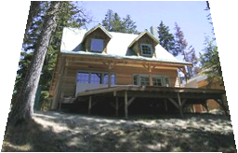
Projective: # correspondences?
?
T(x,y)
y
y’
x
x’
How many DOF?
How many correspondences?

Slide 49
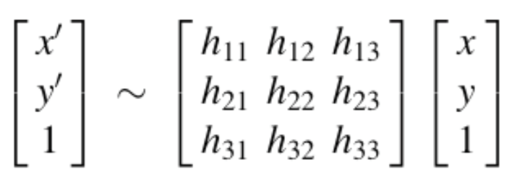
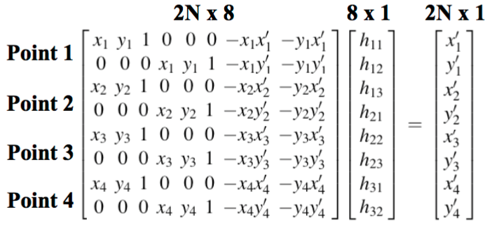
Solving for projective transformation
Simplest solution: given 4 pairs of points, solve in a linear system of equations

Slide 50
RANSAC pros and cons
Pros
Simple and general
Applicable to many different problems
Often works well in practice
Cons
Lots of parameters to tune
Can’t always get a good initialization of the model based on the minimum number of samples
Sometimes too many iterations are required
Can fail for extremely low inlier ratios
We can often do better than brute-force sampling

Slide 51
